Slide 1



Improving White Wine Quality and Inventory Management through Advanced Analytics
Presented By : Group 2-C
Morgan Drouillard
Sathvika Kokku
Joakim Kristensen
Lakshmi Naga Sindhura
University of Tampa| 2024

Slide 2
OVERVIEW
Executive Summary
DELTA Model
Implementation
Issues with Current Business Processes
Conclusion
Introduction
Client Organization Background
Application to Business Problem
Recommendation and References
2
University of Tampa| 2024

Slide 3
EXECUTIVE SUMMARY
Wine on Water is a boutique wine retailer and a valued member of Cru Hospitality Group in Tampa. They want to improve their position in this competitive wine market by using business analytics to choose the best wines for their customers and make them happy. However, they have limited space to store all the different types of wines they want to sell.
To solve this problem, they want to improve their inventory selection process, grow their business and increase their customers satisfaction. So, in this project our team worked with Wine on Water to help them improve their business by selecting some of the best white wines based on their chemical attributes.
3
University of Tampa| 2024

Slide 4

INTRODUCTION
Our project, Wine on Water, aims to use advanced analytics to enhance the quality of white wine and optimize inventory selection based on quality of the wines.
This report provides an in-depth analysis of the organization's current analytical maturity, identifies critical business challenges, and presents a tailored analytics solution focused on improving white wine quality and inventory management processes.
4
University of Tampa| 2024

Slide 5
CLIENT ORGANIZATION BACKGROUND
Wine on Water in Tampa is a small but popular wine shop with over 150 sustainable wines and spirits. About 10 people work there, handling sales, marketing, and inventory. They offer global brands as well as exclusive small batch products. They have outdoor patio ideal for private events and social gatherings.
The shop hosts events and classes to teach about sustainable way of making wine.These events provide customers with opportunities to expand their knowledge and appreciation of wines and spirits, enhancing their overall shopping experience .Thus, it is a favorite spot for locals who love wine and spirits.
5
University of Tampa| 2024

Slide 6
DELTA MODEL ASSESSMENT
Enterprise
Data
Limited budget and small team but interested in customizable analytics solutions.
Wine on Water relies on a Point of Sale (POS) system for most reporting needs, storing data across various systems such as Excel and an email marketing tool.
Targets
Needs clear targets for measuring the success of analytics in improving white wine quality.
Leadership
Analysts
No dedicated analytics team; leadership buy-in is essential for advancing data initiatives.
Decentralized analytics tasks; training and resources needed to boost skills.
6
University of Tampa| 2024

Slide 7
ISSUES IMPACTING BUSINESS EFFICIENCY
1
Despite offering a diverse selection of wines, Wine on Water struggles with inventory optimization due to its small inventory space leading to stock mismatches and missed sales.
2
The organization heavily relies on subjective assessments and past sales data to gauge the quality of wines. However, this approach may not consistently align with broader customer quality expectations.
2
3
The primary issues at Wine on Water revolve around inventory management and marketing, with underlying themes in data utilization and customer satisfaction.
7
University of Tampa| 2024

Slide 8
APPLICATIONS TO BUSINESS PROBLEMS
Predictive Modeling for Quality Assessment
Implement regression or classification models to predict white wine quality based on chemical attributes, enabling proactive inventory selection.
Customer Satisfaction
Inventory Optimization
Align inventory with quality predictions to increase customer satisfaction and loyalty, leading to improved sales and profitability.
Prioritize stocking high-quality white wines to optimize inventory within space limitations.
8
University of Tampa| 2024

Slide 9
DATASET OVERVIEW
The wine quality data set comprises of white variants of wine. This dataset contains numeric attributes representing various physicochemical attributes of wine such as acidity, sugar content, and alcohol concentration.
The 'Quality' attribute serves as the target variable, indicating the perceived quality of wine based on sensory evaluations.
The Quality ratings range from 3 to 9, with higher scores >7 indicating better quality.
White Wine Dataset
Number of Instances: 4898
Number of Attributes: 12
9
University of Tampa| 2024

Slide 10
DATASET MODELS
For our White Wine Quality Dataset, we choose two models:
CHAID Model
The CHAID model helps categorize wines based on specific attributes, facilitating improved customer satisfaction.
Multiple Regression Model
The multiple regression model allows us to predict wine quality based on chemical attributes, aiding in inventory selection.
10
University of Tampa| 2024

Slide 11
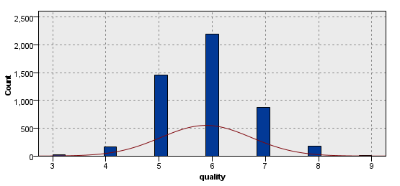

DATA EXPLORATION
The “quality” variable is our target dependent varible for the model.
The histogram shows the variable to be normally distributed.
11
University of Tampa| 2024

Slide 12
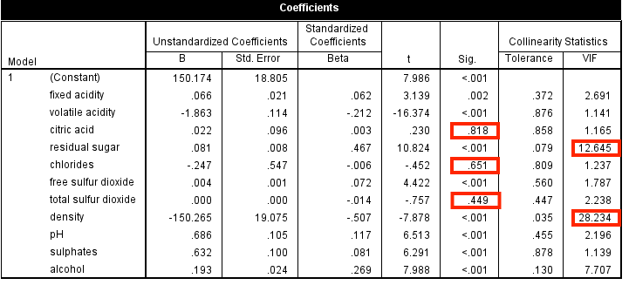
REGRESSION MODEL
Initial analyses shows that certain variables do not meet threshold requirments for accurate model fit.Using scores such as P-Values (Sig. <0.001) and VIF (Greater than 10), we remove the variables and re-run the regression node.
Excluded Variables
Citric Acid
Residual Sugar
Chlorides
Total Sulfur Dioxide
Density
pH (Removed after second model run)
12
University of Tampa| 2024

Slide 13
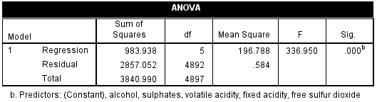
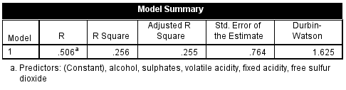
REGRESSION MODEL
The remaining variables are all accepted against the determined thresholds, and we can now move forward with the Regression analysis.
The main value of note is the Significance (Sig) score, otherwise known as the p-value. The p-value associated with the F-statistic is .000b, indicating that the likelihood of observing such a large F-statistic under the null hypothesis is less than 0.1%.
R: = .506
R Square: = .256
Adjusted R Square: = .255
Std. Error of the Estimate: = .764
Durbin-Watson: = 1.625
13
University of Tampa| 2024

Slide 14
REGRESSION MODEL
Based on the metrics, the model is moderately fitting the data with some room for improvement, as indicated by the R Square and Adjusted R Square values.
The presence of autocorrelation as suggested by the Durbin-Watson statistic might warrant further investigation, such as looking into time series dependencies or data collection methods that could have contributed to this pattern in the residuals.
Overall, we can support model fit, significance, and correlation, therefore we are able to construct a regression equation.
Regression Equation
Predicted Value=2.901+(−0.059×Fixed Acidity)+(−1.902×Volatile Acidity)+(0.005×Free Sulfur Dioxide)+(0.367×Sulphates)+(0.338×Alcohol)
14
University of Tampa| 2024

Slide 15
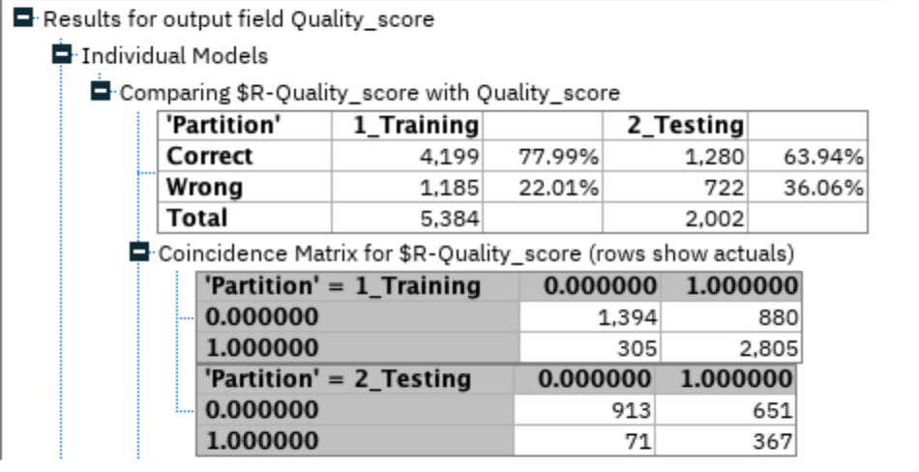
CHAID MODEL
The CHAID model helps us understand the key factors affecting the white wine quality dataset, with the accuracy indicating our model's overall correctness, sensitivity reflecting its ability to identify high-quality wines, and Type II error rate showing the proportion of quality wines not detected.
Analysis of Dataset
Calculations For Testing Data
Accuracy | 63.94%
Sensitivity | 83.79%
Type II Error Rate | 16.21%
15
University of Tampa| 2024

Slide 16
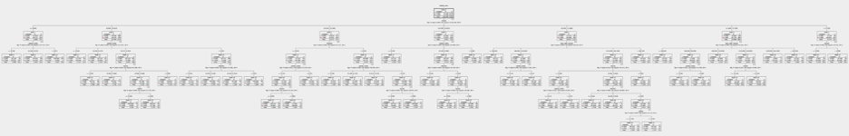
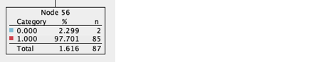
CHAID MODEL
The model’s decision three is visualizing based on our chosen variables, and how it moves from one variable to the next variable is determined by the chi-square test. The chosen node has been moving through the variable's quality, alcohol, sulphates, and to volatile acidity. It has a 97.7% probability to indicate a classification or outcome based on these variables.
16
University of Tampa| 2024

Slide 17
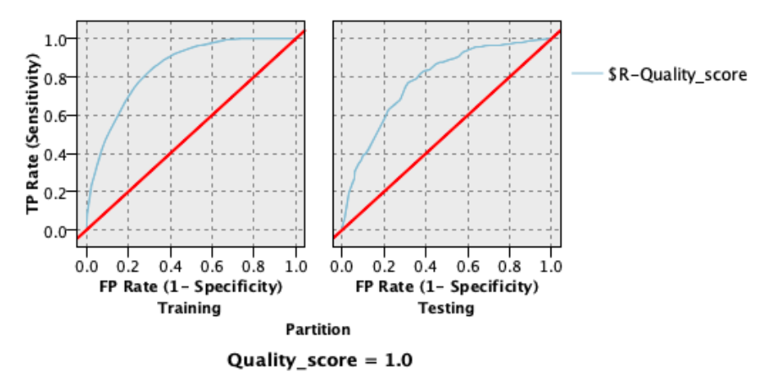
ROC CURVE OF CHAID
When using the ROC curve, our model showed strong predictive ability in the training dataset, with similar consistency in testing. This highlights an effective generalization from training to testing, which is vital for establishing precise classification thresholds for picking out quality in our white wine dataset based on our predictor variables.
17
University of Tampa| 2024

Slide 18
IMPLEMENTATION
Manual Calculation
Staff members are provided with a printed chart or a calculator that contains the regression equation. They manually input the values for fixed acidity, volatile acidity, free sulfur dioxide, sulphates, and alcohol content for each wine.
Quality Score Estimation
Using the equation, they perform the necessary calculations to estimate the 'quality' score of the wines. This could be done with a simple calculator or by following a step-by-step guide that breaks down the equation into an easy-to-calculate format.
Inventory Curation
Based on the calculated 'quality' scores, the staff make decisions on which wines to stock. Wines with higher quality scores, as determined by the regression equation, are selected for the inventory.
Staff and Customer Interaction
When customers seek recommendations, staff use the quality scores derived from the manual calculations to advise on the best wines. They can explain that the recommendations are based on scientific findings related to the wine's chemical composition.
18
University of Tampa| 2024

Slide 19
IMPLEMENTATION PART 2
Visual Aids
Visual aids, such as graphs or charts that show the quality scores of different wines, can be displayed in the store. Customers can view these aids to understand the quality distribution of the wines available.
Record Keeping
A ledger or record book can be maintained to track the quality scores of wines as they are calculated. This can serve as a reference for inventory decisions, customer recommendations, and tracking customer preferences.
Training and Knowledge Sharing
Regular training sessions are held for staff to ensure they understand how to use the regression equation and to help them explain the process to customers, demystifying the science behind wine selection.
Customer Feedback
Feedback forms can be provided to customers to gather their opinions on the quality of the wines they purchase. This feedback is important for assessing the accuracy and effectiveness of the analog method.
18
University of Tampa| 2024

Slide 20
CONCLUSION
Regression analysis helped in identifying predictors like volatile acidity and alcohol content, which could better guide in selection of high-quality wines.
Employing CHAID Classification model, helped in segmenting wines based on key attributes, allowing for targeted inventory optimization and improved customer satisfaction for Wine on Water.
Utilize analytics tool to track monthly sales trends and identify bestselling products.
Form an internal analytics task force led by a dedicated champion to drive adoption.
19
University of Tampa| 2024

Slide 21
REFERENCES
References 1
Wine on Water official website: https://www.wineonwatertpa.com/
Information regarding the organization's services, offerings, and commitment to providing a diverse selection of wines and spirits was obtained from the official website.
References 2
UCI dataset on wine quality: https://archive.ics.uci.edu/dataset/186/wine+quality
The dataset provided valuable insights into wine quality attributes, which were utilized for analysis and recommendations regarding inventory selection and customer satisfaction strategies.
20
University of Tampa| 2024

Slide 22

THANK YOU
University of Tampa| 2024

